Slide 1
Title: Retail Sales Dashboard Subtitle: Interactive Business Insights Your Name: Kalp Sandipbhai Shah Date: 16/05/2025

Slide 2
Project Objective
Design an interactive Power BI dashboard
Analyze retail sales performance using real data
Help business stakeholders understand sales trends, product performance, and customer behavior

Slide 3
Dataset Overview
Source: Retail Sales Dataset (Kaggle)
File: CSV/Excel format
Key Columns:
Transaction ID
Date
Gender & Age
Product Category
Quantity, Price per Unit
Total Amount

Slide 4
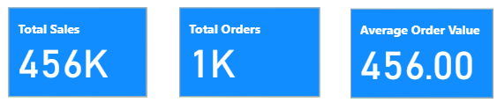
KPIs & Metrics
Total Sales
Total Orders
Average Order Value (AOV)

Slide 5
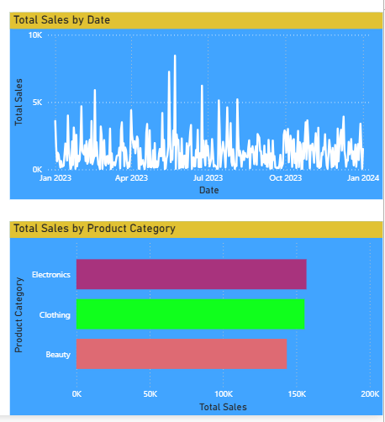
Sales Trend Over Time
Shows how sales change over time
Helps identify trends, seasonality, and growth

Slide 6
Product Category Insights
Breakdown of sales by product category
Identifies best- and worst-selling categories

Slide 7
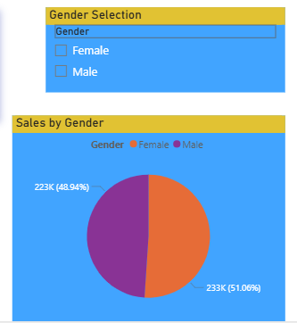
Gender-Based Sales
Compares total sales between male and female customers
Useful for targeted marketing insights

Slide 8
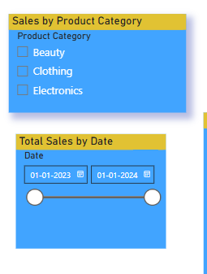
Dashboard Features
Slicers used for:
Date
Gender
Product Category
Dashboard updates dynamically
Improves user experience and exploration

Slide 9
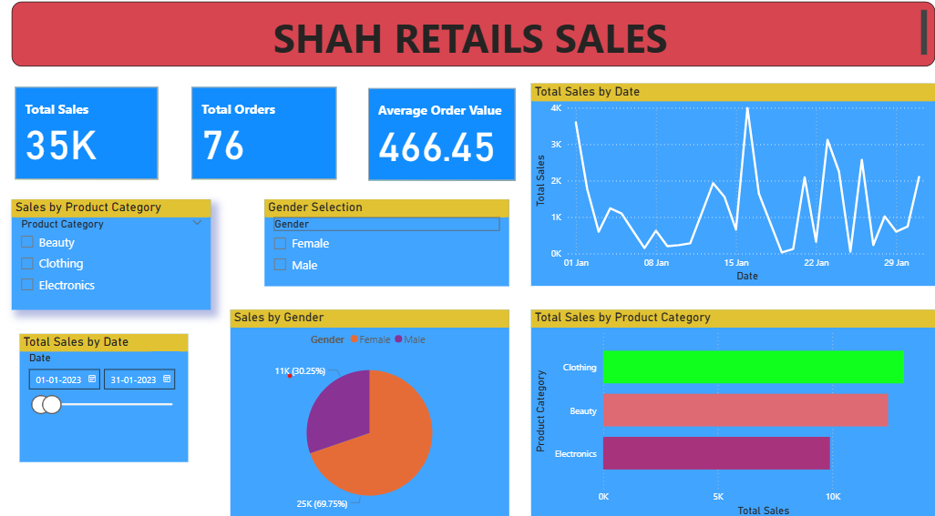
Business Insights
Product Category X generated highest revenue
Sales peak occurred in [month/season]
Female customers contributed to [X]% of total sales

Slide 10
Conclusion
Built an interactive dashboard in Power BI
Helped visualize key retail metrics
Supports better decision-making through data

